Slide 1

Web scraping to gain company insights

Slide 2
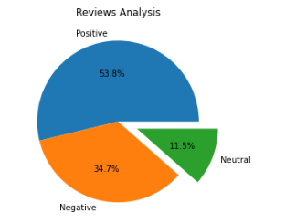
INSIGHTS FROM CUSTOMER REVIEWS
From scrapping through all the data provided . Following is the observation I made and have it visualized in a simple way:
Positive Reviews - 538
Negative Reviews - 347
Neutral Reviews – 115

Slide 3
34.7% of the customers are not satisfied with the service provided . Here’s what they say:
Food and Beverages get 1.8 / 5 as the average rating:
Time Delay in food delivery.
No more than water and just a little pack of chips as a refreshment.
Variety of selection for food us low.
Value for money has 1.6 / 5 as the average rating:
The refund service is slow.
Vouchers and discounts are useless.

